Slide 1

Hybrid Inverter User Manual
GEN-LB-EU 3-6K
Return
Nornal Fault
UP Down Enter
U POWERTEK
Version: UM-GEN01001

Slide 2




uu POWERTEK User Manual
Copyright© 2024 Lux Power Technology Co., Ltd. All Rights Reserved. This manual, protected by the
copyright and intellectual property rights of Lux Power Technology, may not be modified, copied, or reproduced without prior written permission. Brands and trademarks mentioned belong to their
respective owners. Read carefully for product reliability and warranty eligibility. For warranty details, refer to Lux Power Technology Limited Warranty. Intended for professional service providers; no
statements constitute an express or implied warranty.
Descriptions may contain predictive statements; differences may occur. Provided for reference, subject to change without notice by Lux Power Technology.
Website
YouTube
Facebook
尸 www.luxpowertek.com
Scan to download

Slide 3
uu POWERTEK User Manual
Contents
About This Manual .................................................................................................................................... 1
1. Safety..................................................................................................................................................... 1
1.1 Safety Instruction .............................................................................................................................. 1
2. Brief Introduction ............................................................................................................................... 4
2.1 System Solution ................................................................................................................................. 4
3. Installation.......................................................................................................................................... 5
3.1 Packaging List .................................................................................................................................... 5
3.2 Location Selection and Installation ............................................................................................... 6
3.2.1 Requirements for installation location ........................................................................................... 6
3.2.2 Installing the inverter ................................................................................................................... 7
3.3 Connection Overview ..........................................................................................................................9
3.3.1 System connection ........................................................................................................................ 9
3.4 PV Connection ......................................................................................................................................11
3.5 Battery Connection .......................................................................................................................... 12
3.5.1 Battery power cable connection ................................................................................................. 12
3.5.2 Battery communication cable connection ...................................................................................... 13
3.6 Grid & Load Connection .....................................................................................................................14
3.6.1 Grid regulationselection ............................................................................................................ 14
3.6.2 Grid and load connection .............................................................................................................. 14
3.6.3 AC cable connection .................................................................................................................... 15
3.6.4 CT/Meter connection ...................................................................................................................... 17
3.6.5 Safety Standard Configuration - Sw2 ............................................................................................. 18
3.7 Working with Generator ..................................................................................................................... 20
3.7.1 Generator system connection ......................................................................................................... 20
3.7.2 Generator startup and stop settings ................................................................................................22
3.8 AC Coupling Installation Connection ................................................................................................. 22
3.9 Parallel System Connection ................................................................................................................. 24
3.9.1 Connection for paralleling system ................................................................................................ 24

Slide 4
uu POWERTEK User Manual
3.10 Monitor System Setup ................................................................................................................... ₂₇
3.10.1 Wifi/GPRS/4G/WLAN dongle connection ............................................................................... 27
3.10.2 Setup the monitor system ......................................................................................................... 27
3.10.3 Set homewifi password to dongle ........................................................................................... 28
3.10.4 4G dongle monitoring setup ..................................................................................................... 29
3.10.5 Third party RS485 communication .......................................................................................... 29
4. Operation Guide ....................................................................................................................................₂₉
4.1 Operation Mode ................................................................................................................................... ₂₉
4.1.1 Self-usage mode (Default) .......................................................................................................... 29
4.1.2 Charge first mode .......................................................................................................................... 31
4.1.3 AC charge mode ............................................................................................................................ 32
4.1.4 Grid peak-shaving Function ...........................................................................................................32
4.1.5 Smart load Function ........................................................................................................................ 32
4.2 LCD Display....................................................................................................................................... ₃₃
4.2.1 Viewing information and alarm/fault record..................................................................................... 33
4.2.2 Setting parameters ....................................................................................................................... ₃₅
4.3 LCD Screen Settings ₃₉
4.3.1 Button Operation .......................................................................................................................... ₃₉
4.3.2 General Operations ....................................................................................................................... ₃₉
4.3.3 Setting Operation ......................................................................................................................... ₄₀
4.3.4 Faults & Warnings Function ........................................................................................................ 41
4.3.5 Subpage Selection ........................................................................................................................... ₄₁
4.3.6 Special Operation .............................................................................................................................₄₂
5. Troubleshooting & Maintenance ......................................................................................................43
5.1 Regular Maintenance ₄₃
5.2 LED displays...................................................................................................................................... 43
5.3 Troubleshooting based on LCD displays ............................................................................................ 43
5.4 Fan replacement ................................................................................................................................... 48

Slide 5
uu POWERTEK User Manual
Revision History
Version | Date | Description
UM-GEN01001 | 2024.06.07 | First official release.
safety
1.1 Safety Instruction
General Safety Instructions
The inverter has been designed and tested strictly according to international safety regulations. Read all safety instructions carefully prior to any work and observe
them at all times when working on or with the inverter. The operator must be qualified personnel and the installation must be capable with relevant national or international standards or regulations.
Incorrect operation or work may cause:
- injuryor death to the operator or at third party
- damage to the inverter and other properties belonging to the operator or a third party.
1

Slide 6
uu POWERTEK User Manual
Important Safety Notifications
There are many safety issues need to be carefully notified before, during and after the installation, and also in future operation and maintenance, following is important safety notifications to operator, owner and user of this product in appropriate usage
! DANGER
Dangers of High Voltages and Large Current Beware of high PV voltage. Please turn-off the DC switch of PV Panel output before and during the installation to avoid electric shock. Beware of high grid voltage. Please turn-off the AC switch of grid connection before and during the installation to avoid electric shock. Beware of large current of the battery output. Please turn-off the battery module before and during the installation to avoid electric shock. o Do not open the inverter when it's working to avoid electric shock and damages from live voltage and current from the system. Do not operate the inverter when it's working, only the LCD and buttons can be touched in limited cases by qualified personnel, other parts of the inverter can be touched when the inverter is under a safe state(e.g. fully shut-down). Do not connect or disconnect any connections (PV, battery, grid, communication etc.) of the inverter when it's working. Make sure the inverter is well grounding, an operator should make sure himself is good protected by reasonable and professional insulation measurements (e.g. personal protective equipment (PPE)). Inspect relevant existed wiring on-site of the installation is under good condition before installa- tion, operation or maintenance. Inspect the connections are good between inverter and PV, battery and grid during installation to prevent damages or injuries caused by bad connections.
2

Slide 7
uu POWERTEK User Manual
Avoid Misoperation and Inappropriate Usage All the work of this product (system design, installation, operation, setting, configuration and maintenance must be carried out by qualified personnel as required. o All connections must be in accordance with local and national regulations and standards. o The inverter and system can inter-connected with the utility grid only if the utility grid permits it. o All the warning labels or nameplates on the inverter must be clearly visible and must not be removed, covered or pasted. The installation should consider the safety of future users when choosing the right position and location as specified in this manual. o Please keep the children away from touching or misusing the inverter and relevant systems. o Beware of burning hurt, the inverter and some parts of the system could be hot when working, please do not touch the inverter surface or most of the parts when they are working. During inverter working states, only the LCD and buttons could be touched.
! WARNING
Avoid Misoperation and Inappropriate Usage o Please carefully read this manual before any work is carried out on this inverter, the installation, please keep this manual carefully stored and easy to access at any time. o The qualified personnel should have had training in the installation and commissioning of the electrical system as well as dealing with hazards, also they should have the knowledge of the manual and other related documents. As the installer or operator they are required to be familiar with local regulations and directives.
NOTICE
3

Slide 8






User Manual
2. Brief Introduction
2.1 Brief Introduction
This product and relevant system is suitable for following system applications (system diagram):
A. Solar and battery storage system |  | B. AC Coupling with existed solar system Existing On-grid Solar System
LOAD
C. On-grid solar system without battery (Support load even without battery) |  | D. Off-grid and back-up applications LOAD
E. Single and three phase paralleling system LuxPower Router Grid |  | F. Off-grid and generator applications
Nornal Fault Return UP Down Enter
Return
Nornal
Fault
UP
Down
Enter
LOAD
Down
Down
Nornal
Fault
Nornal
Fault
UP
Enter
R
UP
Enter
Reserved Battery &Load Interfaces
Return
Nornal
Fault
UP
Down
Enter
LOAD
4

Slide 9

















uu POWERTEK User Manual
3. Installation
3.1 Packaging List & Storage Instructions
Packaging List
When the packaging is unpacked, the inner components should be the same as described in below packaging list.
Hybrid Inverter X1
User Manual X1
Wi-Fi Module X1
Grid Connector
Load Connector
Hybrid Inverter User Manual GEN-LB-EU 3-6K uu POWERrex Version: UM-GEN01001
Rj45 Terminal X4
Cross Head Screw X13
Expansion Screw and Tube X4
Security Screw X1
GEN Connector
Communication Port Cover X1
CT X1
4mm Allen Key
PV Connector X4
Communication cable L= 2m X 1(Orange)
Parallel Communication cable L=2m X 1(grey)
Battery
Guardrail barrier
Wall-mounted Bracket X1
Connector for BAT+
Connector for BAT-
5

Slide 10
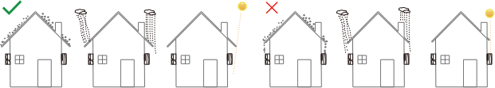
User Manual
3.2 Location Selection and Installation
3.2.1 Requirements for installation location
a). The wall for mounting should be strong enough to bear the weight of inverter.
b). Please maintain the minimum clearances below for adequate heat dissipation.
400mm
Nornal Fault Return UP Down Enter
400mm
Nornal Fault Return UP Down Enter
400mm
Nornal Fault Return UP Down Enter
400mm
Nornal Fault Return UP Down Enter
Nornal Fault Return UP Down Enter
Nornal Fault Return UP Down Enter
Nornal Fault Return UP
Nornal Fault Return
Nornal Fault Return
Nornal Fault Return UP Down Enter
Nornal Fault Return UP Down Enter
Nornal Fault Return UP Down Enter
Nornal Fault Return UP Down Enter
Nornal Fault Return UP Down Enter
c). Never install the inverter in a place with direct sunlight, rain or snow. Please refer to below figure and select a well shaded place or install a shed to protect the inverter fro direct sunlight, rain and snow etc. PROTECT the LCD screen from excessive UV exposure.
6

Slide 11


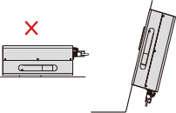
User Manual
d). The inverter should be installed upright on a vertical surface.
>75
90
>90
90
3.2.2 Installing the inverter
The inverter is wall-mounted type and, should be installed on a vertical, solid mounting surface, such as wood studs, brick or concrete wall. Two or more persons may be needed to install the inverter due to its weight.
The mounting steps are as below: (Use brick wall as example)
7

Slide 12
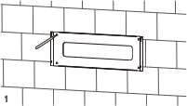
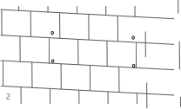

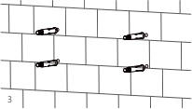
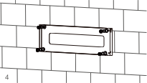
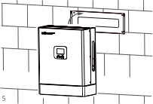
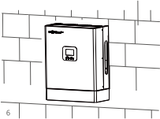
User Manual
Step 1. Mark the positions of drill holes with the mounting bracket, then drill 4 holes of
8mm (5/16inch) diameter and make sure the depth of the holes is deeper than 50mm(2inch).
Step 2. Install and tighten the expansion bolts into the holes.Then use the corresponding nuts and washers (packaged together with the expansion bolts) to install and fix the wall-mounting bracket on the wall.
Step 3. Hang the inverter onto the wall-mounting bracket and lock the inverter on the wall using one Hex socket countersunk screw screw onto the right side of the heatsink.
For installation on wood studs
Fasten the mounting bracket on the studs with 4 wood screws, then hang the inverter onto the bracket and lock the inverter on the wall with 2 self-tapping screws. Please note that the wood screws and self-tapping screws are not provided with the inverter. Installers need to prepare the screws before installation.
8

Slide 13


uu POWERTEK User Manual
3.3 Connection Overview
3.3.1 System Connection
LU Nornal Fault Return UP Down Enter
K
D
N
D
L
PE
O
D
Generator breaker
Main Breaker
PV Breakers
+
+
L N L N L N
AC
Battery
Breaker
Breaker
aw
Load Breaker
Backup Load
Load
* Note:
1, Max. AC input is 52.7A
2,About the "Load" terminal on the Inverter
In our inverter system, there is a port labeled "Load," which is specifically used to connect essential loads. On the inverter's LCD screen, this terminal is labeled as "EPS," indicating Emergency Power Supply.
In some sections of our manual, this terminal is also referred to as "Backup Load."
Regardless of the term used, these all refer to the same port, which functions to ensure that,
in the event of a power outage, the connected critical loads can continue to be powered by solar panels or the storage battery, thereby maintaining the operation of essential devices.
Please prepare the breakers before connection, breakers selection recommendation for both DC and AC
Inverter model | GEN-LB-EU 3-6K
PV Breakers (2Px2) | 600V/20A
Battery Breaker (2P) | 100V/250A
Main Breaker (2P) | 63A/230Vac
Load Breaker (2P) | 40A/230Vac
Generator breaker | 40A/230V
9

Slide 14
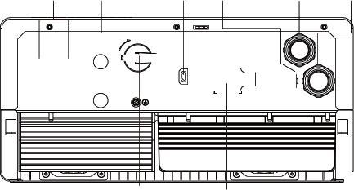
User Manual
Connection Terminals and Interfaces Overview
Battery Terminals
PV
Terminals
Wi-Fi Module
GEN
Terminal
AC
Terminal
LOAD
Terminal
PV1+
ON
Wireless
Communication
GEN
CT/Meter
GRID
+ BAT ⁻
PV1-
PV2+
PV2-
OFF
ON 1 2
LOAD
ON 1 2 3 4 5
NO COM CAN
BAT COM
P1-485B
P2-CANH
P4-CANL
P5-CANL
PARALLELCAN
DC
Switch
Communication Interfaces
b
CT/Meter
Wireless ON
Communication
1 2 3 4 5
ON
1 2
NO COM NC
BAT COM
P1-485B
P2-485A
P4-CANH
P5-CANL
a
i
e
c
d h
PARALLELCAN
f ^{g}
a | For detailed interface definitions of CT&METER 485 and INV 485, please refer to section 3.6.3.
b | Safety code dip switch: set different safety codes by adjusting the dip switches. For corresponding safety codes, please refer to section 3.6.5.
c | CAN Matching resistance: Set DIP switch when use inverters in parallel
d | Connection for temperature sensor of lead-acid battery
e | Battery communication port (CAN&RS485) please check Chapter 3.5.2 for Pin definition
f | Parallel communication port
g | Please check Chapter 3.9 for Parallel connection
h | GEN (NO, NC) : Connection forgenerator auto-start function
i | Wifi/GPRS/4G/WLAN dongle connection
10

Slide 15
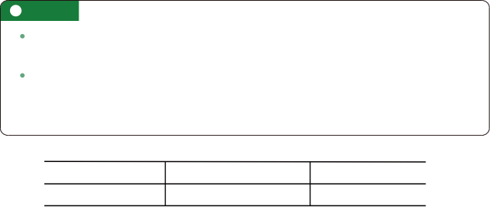


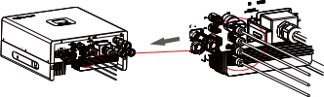
User Manual
3.4 PV Connection
The PV connection of GEN hybrid inverter is the same to traditional on-grid solar inverter (string inverter) .
Before connection the PV, please use the multi-meter to measure the PV array voltage to verify if PV array is working normally, if not, please fix the PV array to normally working states before connection
When your PV panel ambient temperature could possibly be lower than 0℃, then please check the PV array voltage up ceiling and if you are not sure please ask your system or panel provider for further assistance. As when temperature is extremely low the PV panel voltage will increase by a certain percentage.
Cable Requirement:
Cross-section Cable Diamet er Minimum Voltage
3 - 6 mm ² 2-2.6mm 600V
Step 1 : Turn off or disconnect the PV switch (DC switch) . Then keep this switch always open during the connection.
Step 2: Assemble the PV connector
6-8 mm
a) . Strip 6~8mm insulation from the cable end.
b) . Assemble the cable ends to crimp contacts.
Negative Crimp Contact
Positive Crimp Contact
c) . Lead the cable through the cable gland, then insert into the corresponding insulator until it snaps into place, then tighten the cable gland.
When verified the PV connector is tightly, align the 2 half connector and mate them together by hands until ‘click’ is felt or heard.
11

Slide 16
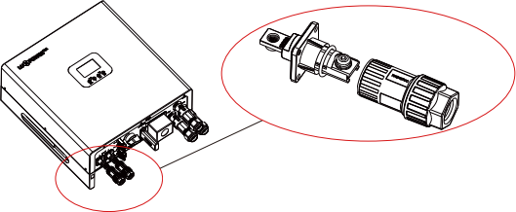
User Manual
3.5 Battery Connection
3.5.1 Battery power cable connection
Cable Requirement:
Model | Cable Size | Minimum Voltage | Torque for cable connection | OT ring
5K/6K | 1 -2AWG(35-50 mm ² ) | 600V | 20(N m) | RNB35-6
Step 1 : Strip 1/4-5/16inch(6-8mm) insulation from the cable end and crimp Cable lugs for the cable ends.
Step 2: Route the battery power cable through the cable gland, connect positive to BAT+,negative to BAT- .
Step 3: Secure the conduit fitting to the enclosure using the counter nut .
Step 4: Fasten the OT rings of battery positive and negative cables to the lugs according to the marking.
Step 5: Fix the cable gland in place .
12

Slide 17
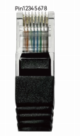
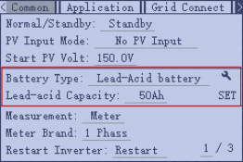
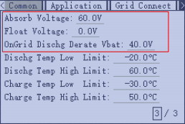
uu POWERTEK User Manual
3.5.2 Battery communication cable connection
A correct battery communication cable must be used to connect the battery to the inverter when users choose lithium-ion battery type. Please select ‘Lead-acid ‘ type if the lithium battery can not communicate with inverter. The battery communication port on inverter is a RJ45 socket , Pin for the RJ45 plug of the communication cable is as below. Make the
communication cable according to the below inverter Pin and the correct pinout of
communication port on battery. The inverter supports both CAN and RS485 communication.
If using a Lux power battery, select lithium type for option 6: Lux power; for Hina battery, select lithium type option 1: Hina Battery.
Pin | Description
1 | BAT RS485 B
2 | BAT RS485 A
3
4 | BAT CAN H
5 | BAT CAN L
6
7
8
Wireless Communication NO COM NC 1 PARALLELCAN P1-485B P2-485A P4-CANH P5-CANL
CT/Meter ON 1 2 3 4 5
ON 1 2
BAT COM
After battery power cable and communication cable connection, users need to enter Advanced setting and choose Battery type and brand on the inverter LCD
For Li-ion battery 1. Please make sure the lithium-ion battery to be used is compatible with our inverters. Please contact your distributor for updated battery compatible list. 2. If you are using multiple battery modules with the inverter, the inverter communication cable must be connected to the master battery. Please check with your battery supplier for battery master and slave settings. For Lead-acid battery 1. The temperature sensor for lead-acid battery is optional. If you need it, please contact distributor for purchasing. 2. There are three stages for lead-acid battery charging. For charging/discharge related parameters, "Setting->Common Page 3" Modify the "Page 3" settings (this page will appear only when set to lead-acid battery).
NOTICE
13

Slide 18
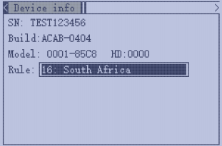
uu POWERTEK User Manual
3.6 Grid & LOAD Connection
3.6.1 Grid regulationselection
Our inverters are compliant with on-grid regulations in several areas, including standards such as NRS 097, G99, G100, and more. When making the selection, please ensure alignment with the specific regulations in your area.
3.6.2 Grid and load connection
The inverter can be connected to the load side of the service disconnecting means if the busbar rating in the main panel can meet the NEC705.12(B)(3) requirements. Otherwise, a Line side
connection can be made to avoid an expensive main panel upgrade.
Grid and Load Connection
Utility Meter
 | PE
CT
kW. h
LOAD |  | GEN |  | GRID
L | N | L | N | L |  | N
7 | 9 | 8 | 6 | 6
480r/kW. h 10A
凸
CT L N | PE
L | N | PE
NOTICE
Inverter Disconnect
PE N L | Generator
Main Panel
Backup Panel
Generator Disconnect
14

Slide 19
User Manual
3.6.3 AC cable connection
Cable Requirement:
 | Cable Size | Minimum Voltage
Grid terminal | 8-6 AWG(9-14mm2) | 600V
Load/Gen terminal | 10AWG(4-6mm2) | 600V
Step 1: Installation of Grid Connector
Component Overview
Socket
Terminal Block
Cable Seal
a) . Thread the AC cable through the cable sealand socket . Insert the conductors fully into the corresponding terminals of the terminal block and tighten the screws .
15

Slide 20
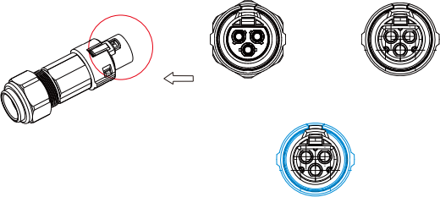
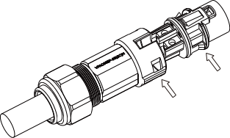
User Manual
b). Refer to the image to ensure correct AC cable connection.
Grid terminal is black, without foolproof design
Load terminal is black, with foolproof design
GEN terminal is blue,
with foolproof design
c). Assemble the Grid connector,ensuring that the ribs of the terminal block and the grooves on the housing are fully engaged until you feel or hera a distinct “click”.
Step 2: Installation of Load Connector
a) . Align the Load connector with the AC terminals, and manually engage them until you hear or feel a distinct “click” .
b) . Install a n AC circuit breaker (AC switch) between the inverter and the grid. Before
connecting the AC cable from the inverter to the AC circuit breaker, ensure the AC circuit breaker is functioning properly. Close the AC circuit breaker and leave it in the open
position.
c) . Connect the PE conductor to the grounding pole, and connect the N and L conductors to the AC circuit breaker.
d) . Connect the AC circuit breaker to the AC grid.
e) . Install a separate single-phase circuit breaker or other load disconnection device for each inverter to ensure safe disconnection under load.
16

Slide 21

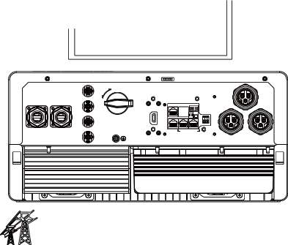
User Manual
The inverter features residual current detection and protection functions. If the inverter must be equippedwith an AC circuit breaker with residual current detection capability. AnAC circuit breaker with a rated residual current greater than 300mA must be selected.
NOTICE
3.6.4 CT/Meter connection
To measure the power import from and export to the grid, a CT or one meter must be installed at the service entry point in or near the main service panel. We standard supply 1 CT for one inverter.
Extend CT clamp cable
The CT interface for 1 CT connection is a RJ45 port, we have made a RJ45 plug on tose 1 CT in advance, so you can connect it to port directly.
Pin | Description
1 | Meter RS485 B
2 | Meter RS485 A
3 | INV RS485 B
4 | INV RS485 A
5 | CT N
6 | CT P
7 | CT N
8 | CT P
Wireless Communication | NO COM NC _{BAT} _{COM} PARALLELCAN P1-485B P2-485A P4-CANH P5-CANL
CT/Meter
ON 1 2 3 4 5
O N 1 2
Pin
5 6
7 8
CT
L
TO PCS
TO Grid
P N
Pin8 Pin7
PV1+
ON
Wireless
Communication
GEN
ON
1 2 3 4 5
O N
1 2
NO COM CAN
PARALLELCAN
GRID
LOAD
PV2+
PV2-
+ BAT ⁻
PV1-
OFF
CT/Meter
BAT COM P1-485B
P2-CANH P4-CANL P5-CANL
Grid
17

Slide 22
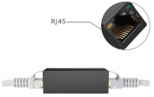
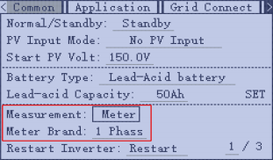
uu POWERTEK User Manual
Please refer to the above connection diagram for the correct positions of CTs. The arrows on the CTs must point to inverter side.
CT Clamp Ratio
The inverter support 3 ratios of CT clamp-1000:1, 2000:1 and 3000:1. The CT ratio in the accessory bag is 1000:1. 1f you are using a 3rd party CT, please ensure the CT ratio is one of them, and select the
correct CT ratio setting in the inverter monitor page or on the inverter LCD.
Extend CT clamp cable
The CT wires can be extended with a common ethernet cable if the
length is not enough. An RJ45 adapter is needed for the extension.
The CT wires can be extended up to 300ft(around 100m).
Meter Connection
Currently only EASTRON Modbus version meters can be used. If you need to use meter for
import/export detection instead of CT, you need to connect it to the Meter 485A and 485B terminals on the inverter, please contact Luxpower for detailed guideline.
Wireless Communication | NO COM NC PARALLELCAN P1-485B P2-485A P4-CANH P5-CANL
CT/Meter I O N 1 2
ON 1 2 3 4 5
BAT COM
3.6.5 Safety Standard Configuration Guidance
After upgrading the software to version ACAB-0404, it will no longer be possible to set safety standards using the DIP switch.If the software is upgraded from a version prior to ACAB-0404 to ACAB-0404, the previous DIP switch settings for safety standards will be retained and not changed.
The current software version can be viewed directly on the machine’s LCD screen . Here’s how you can access and check the version, as well as adjust the safety standard:
18

Slide 23
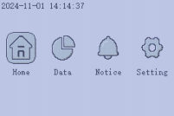
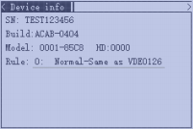
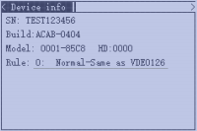
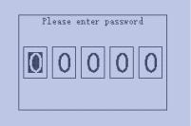
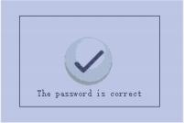
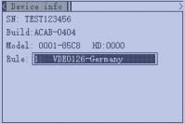
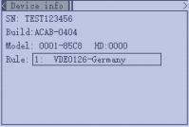
uu POWERTEK User Manual
Go to the Settings menu
Navigate to Device Info , where you’ll see the software version displayed as:Build: ACAB-0404
Go to this page, press Enter
 | · A pop-up will appear requiring a password. The default password is 00000 . · You can change the password in the monitoring settings.
Entering the Safety Standard Setting Select the appropriate safety standard and press Enter to confirm. |  | Press Enter again to select Rule , then use Up or Down to scroll through the options. (Supported inverter regulations are listed in the table below) Once successfully set , the machine will automatically restart , and the selected safety standard will display after the restart .
Enter
Enter
Enter
19

Slide 24
uu POWERTEK User Manual
Safety Standard Details:
0. Default VDE0126
1. Germany VDE0126
2.Australia AS4777
3. New Zealand NZS
5.G99
6.G98
7. Germany N4105
8. ltaly CE10-21
9.Europe EN50438
10. Finland EN 50438
12. Thailand PEA
13.Thailand MEA
14.lreland EN 50438
15. Czech EN 50438
16. South Africa NRs 097-2-1
18.CEIO-21 ARET
19.En50549
22.Spain RD 1699,RD 413,RD 647, UNE 217001, NTS TYPE A
23.Belgium C10/c11
20

Slide 25
uu POWERTEK User Manual
3.7 Working with Generator
3.7.1 Generator system connection
This hybrid inverter can work with generator. There are Gen ports on the inverter for generator connection
Generator Connection-Partial Backup
CT
Utility Meter
 | PE O
kW. h
480r/kW. h 10A
LOAD |  |  |  |  | GEN GRID
L |  | N |  |  | L |  |  | N L |  |  |  |  | N
7 | 9 | 8 | 6 | 6
凸
 | CT
L N
 |  | PE
L N PE
Inverter Disconnect
PE N Generator L
Main Panel
Backup Panel
2-wire start
Generator
Disconnect
21

Slide 26
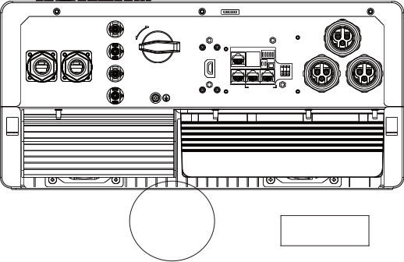
User Manual
Generator Connection-Partial Backup
CT
Utility Meter
 | PE
kW. h
480r/kW. h10A
LOAD GEN GRID L N L N L N
7 9 8 6 6
N L PE
Service
Disconnect
CT
L N
 | PE
Inverter Disconnect
PE L
N Generator
2-wire start
Backup Panel
Generator
Disconnect
When the generator is started, all loads connected to the LOAD interface will be supplied by the
generator.
The maximum current for the generator port connector is 35A. Please ensure that the total load does not exceed 35A when starting the generator.
PV1+
ON
Wireless
Communication
GRID
+ BAT -
PV1-
PV2+
PV2-
OFF
GEN
CT/Meter LOAD
ON
1 2 3 4 5
O N
1 2
BAT COM P1-485B
P2-CANH P4-CANL P5-CANL
PARALLELCAN
NO
COM CAN
NO
COM NC
Generator
22

Slide 27
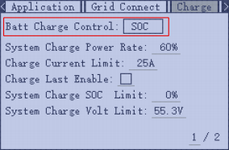
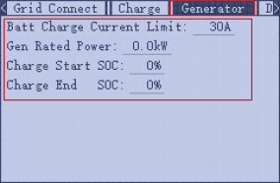
uu POWERTEK User Manual
3.7.2 Generator Startup and Stop settings
It depends on the Bat operating mode setting, The system will use either battery SOC or battery voltage to determine whether the system needs to start or stop the generator.
Generator Start Conditions
When utility fails and
-When battery is discharged to cut-offsettings
or there is force charge request from battery.
or when the battery voltage or SOC islower than the Generator Charge start Volt/SOC setting value.
Generator Stop Conditions
when battery voltage or SOC is higher than Charge end Volt/SOC setting value.
3.8 AC Coupling Installation Connection
The inverter supportsAC coupling connection with the existing on-grid solar system. The existing solar system is connected to the inverter's GEN port.
CT
^{Connection} ^{for} ^{AC} ^{coupling} ^{solar} ^{system} Utility Meter
 | PE
kW. h
480r/kW. h10A
LOAD |  | GEN |  | GRID
L | N | L | N | L | N
7 | 9 | 8 | 6 | 6
凸
Inverter Disconnect Main Panel
CT
L N
PE
L N PE
Existing Solar ^{Backup} ^{Panel}
System
23

Slide 28
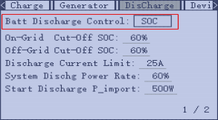
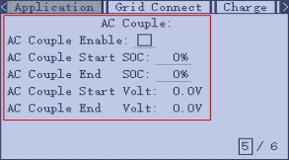
uu POWERTEK User Manual
After AC couple function enabled:
When the Grid is on, the GEN terminal is connected to the grid terminal inside the inverter. In this case the hybrid inverter will bypass the interactive inverter AC to the grid and Load.
When grid is off, The GEN terminal is connected to the LOAD terminal inside the inverter. In this case, the loads will be first supplied by solar power. If solar panels are generating more power than load
consumption, the excess solar power will be stored to the battery. When solar power exceeds the sum of load power and max battery charging power, e.g. when battery is nearly full. The inverter will signal the grid interactive inverter to reduce power via the frequency shifting power reduction mechanism, thus to maintain the balance of generation and consumption of the micro grid system.
AC Coupling Settings
Users need to enable AC coupling function when they connect existing on grid system to GEN terminal
Start SOC(%): The SOC at which the AC coupled inverters are turned on when in off-grid mode. 50%~70% recommended
End SOC(%): The SOC at which the AC coupled inverters are shutdown when in off-grid mode. 90% recommended
When On-Grid and Grid Sell Back enabled, the AC coupling inverter will always be on, and it will sell any extra power back to the grid. Ensure you are allowed to sell power to your utility provider.
When Grid Sell Back is disabled, the AC-coupled inverter will stay at off mode and could not work at on-grid mode to sell power to utility grid.
24

Slide 29

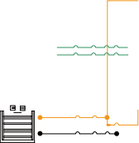
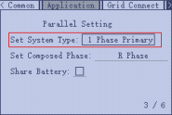
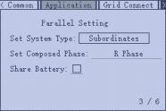
uu POWERTEK User Manual
3.9 Parallel System Connection
3.9.1 Connection for paralleling system
The hybrid inverter supports parallel connection to expand power and energy capacity to suit
different using scenarios. Up to 10 units can be paralleled to reach a capacity of 60kW. Wiring
diagram is as below, The manual bypass switch connect essential loads to LOAD panel for default. When inverters fail, users can switch the loads to utility.
Single Phase parallel system Utility Meter
CT
kW. h
Inverter 1
7 | 9 | 8 | 6 | 6
PV GRID
CAN 1 CAN 2 BAT | GEN LOAD
L
N
PE
480r/kW. h 10A
L N PE L
N PE L N PE L
L
GRID
CT
N
PE
<
PE
L N
Inverter 2
PV CAN 1 CAN 2 BAT | GRID GEN LOAD
Generator
L
N
L N
PE
PE
Inverter 3
Load
PV CAN 1 CAN 2 BAT | GRID GEN LOAD
N PE
L
L
N
N
PE
PE
L
N
PE
PE
Inv1 setting
Inv2 setting
Inv3 setting
25

Slide 30
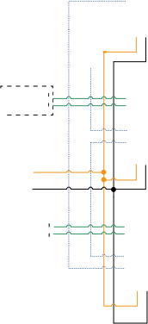


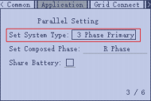
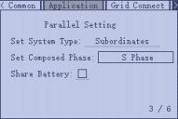

uu POWERTEK User Manual
Three Phase parallel system
L1
N
L3
L2
Utility Meter
Inverter 1
kW. h
PV CAN 1 CAN 2 BAT | GRID GEN LOAD
L
CT
CT
CT
7 | 9 | 8 | 6 | 6
。 ^{N} 。 ^{PE}
L2
480r/kW. h 10A
L N
L3 L1
PE
GRID CT
L1
L2
L3
N
PE
L1
L2
L3
N
PE
L1 L2 L3 N
L
< <
PE
<
L PE ——
N
Inverter 2
PV CAN 1 CAN 2 BAT | GRID GEN LOAD
N PE
Generator
L N
L
L
N
PE
L
N
·
PE
Inverter 3
Load
PV CAN 1 CAN 2 BAT | GRID GEN LOAD
N
PE
c _{PE}
 | N
L
PE
PE
Inv1 setting Inv2 setting Inv3 setting
26

Slide 31
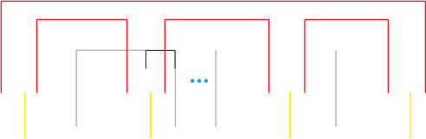





User Manual
Please put the CAN communication PIN to on status for the first and the end inverter
Parallel line(n to 1) The max. parallel quantity is 10, so 2<n≤10
Parallel line1 Parallel line2 Parallel line(n-1 to n)
ON
1 2
ON 1 2
ON 1 2
ON 1 2
No.1
1
0
1 1
No.2
1
0
0 0
No.n-1 1 0
0 0
No.n
1
0
1 | 1
If the parallel cable is not enough or long enough, please make a straight pin to pin cable.
Settings for paralleling function in monitor system
1. Set up monitoring for the system, add all dongles to one station. Users can login to visit the monitoring system, Configuration-> Station-> Station Management-> Add dongle.
Configuration
Asia
A
T
文
Monitor Data
Overview
Maintenance
T
English
Stations
₊ Add Station
Search by station name
Dongles
Devices
Users
Operation Record
Plant name | Installer | End User | Country | Timezone | Daylight saving time | Create date | Action
1 |  |  | South Africa | GMT+2 | No | 2019-03-14 | Station Management
2 ierHce | Ean geni |  | South Africa | GMT+2 | No | 2019-03-25 | Station Management
3 office |  |  | South Africa | GMT+2 | No | 2019-06-03 | Station Management
4 |  |  | South Africa | GMT+2 | No | 2019-07-16 | Station Management
2. If the system shares a single battery bank,enable the shared battery function otherwise disable the shared battery function.
3. Set the system as a parallel group in the monitor system
T
T
English
Monitor Data Configuration
Overview
Maintenance
Asia
文
A
Stations Overview
Station Name
Search by inverter SN
Device Overview
Serial number Status Solar Power Charge Power Discharge Power Load Solar Yield Battery Dischar Feed Energy ConsumptionEr Station name Parallel Action
 | Normal 228 W | 42 W | 0 W | 182 W | 215.3 kWh | 39.6 kWh | 0 kWh | 551.2 kWh | Dragonview | Parallel
 | 35 W | 32 W | 0 W | 0 W | 158.7 kWh | 21.1 kWh | 0 kWh | 160.5 kWh | Dragonview | A-2 | Parallel
 | 1 kW | 129 W | 0 W | 1 kW | 170.3 kWh | 49.9 kWh | 0 kWh | 434.5 kWh | Dragonview | A-3 | Parallel
1
2
3
4
A-1
79 W
48 W
0 W
106 W 99 kWh
85.6 kWh
0 kWh
257.1 kWh
Dragonview A-4 Parallel
Please contact your inverter supplier for more detailed guidance for paralleling system
Notices for parallel system: A. Ensure the Generator is connected to all systems in parallel (if application). B. If you cannot divide the number of PV panels connected to each inverter, it is recommended to have more PV panels in the primary inverter. C. The values shown on the LCD of each inverter represent the inverter’s contribution, not the total contribution of thr system.
Parallel System Notice
27

Slide 32
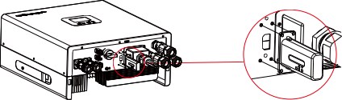
User Manual
3.10 Monitor System Setup
3.10.1 Wifi/GPRS/4G/WLAN dongle connection
Users can use a WiFi/ WLAN /4G /2G dongle to monitor their inverter, and view the monitoring data on a computer or smart phone remotely.
To view data on smart phone, please download APP from the Google Play or Apple APP store, then login with the user acconunt.
WIRELESS
COMMUNICATION
GRID
COMMUNICATION
+ BAT
-
PV1+ ON
WIRELESS
GEN
PV1-
INV
3.10.2 Setup the monitor system
1. Sign up an account on the mobile phone APP or Website
The "customer code" is a code we assign to your distributor or installer. You can contact your
supplier for their code.
2. The station and wifi dongle will be created auto when you register, if you want have more stations need to be created, you can create as below.
Cluster: America
* Cluster
North America
Station name / Serial number
 | User name
 | Pass word
* Username
N.Wilson
Normal
* Password
EDIT
ADD DONGLE
Remember username Auto login
* Repeat password
Real name
LOGIN
* E-mail
Tel number
Chris White
EDIT
Normal
Forget password?
or
* Station name
ADD DONGLE
* Daylight saving time
Luis de Soto
EDIT
Offline
* Continent
* Region
* Country
* Timezone
* Address
North America
North America
United States of America GMT - 5
ADD DONGLE
 | REGISTER
Clive power Normal
DONGLE CONNECT
* Installer code * Dongle SN * Dongle PIN
EDIT
ADD DONGLE
PRODUCT WARRANTY | LOCAL CONNECT
DOWNLOAD FIRMWARE
Areaux
EDIT
Notice
REGISTER
ADD DONGLE
Version 3.2.3 - Privacy Policy
28

Slide 33
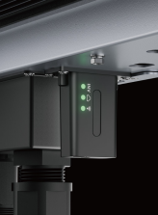
uu POWERTEK User Manual
3.10.3 Set homewifi password to dongle
1 . connect your mobile phone to the " BAxxxxxxxx" wireless network where " BAxxxxxxxx" is the serial number of the wiFi dongle.
2 . click the "wiFi MODULE CONNECT" button on the APP
3 . select the home wiFi that the wiFi dongle is to be connected to, and enter the wiFi's password. And then click " Homewifi connect" . The wiFi dongle will restart and try to connect to our server automatically.
4. check the LEDs' status on the wiFi dongle. The middle light should be solidly lit when the wiFi dongle connects to our server successfully.
12:20 CMCC
Connect WIFI module to the home WIFI
WI-FI
 | User name
 | Pass word
Home Wifi: unknown ssid
Password: Please input password
BA 19520257
Obtaining address. . .
User
User_5g
User 2
ChinaNet - wG49
CMCC-BAKR
HF-WIFI
ChinaNet-EWP
User_5G
MORE SETTINGS
Remember username Auto login
LOGIN
 | Homewifi Connect
 |  | Connect your mobile phone to the Baxxxxxxxx wireless network first. Then enter the HomeWifi and password of homeWifi, and click HomeWifi Connect.
Forget password?
or
DONE
 | REGISTER
Set with Bluetooth
DONGLE CONNECT
PRODUCT WARRANTY | LOCAL CONNECT
DOWNLOAD FIRMWARE
Version 3.2.3 - Privacy Policy
5. Now you can disconnect your mobile phone from the “BAxxxxxxxx” wireless network. Login on the APP with your account, you'll find the inverter information already appears. Now you'll be able to
monitor and control the inverter remotely on any smart phone or computer that has an Internet connection.
Please download the following guides for setting up WiFi dongle and monitoring account at Document Reference:
1. Wifi Quick Guidance
Quick guidance for setting connection of WiFi module to home WiFi, you can also find a printed version in the packaging of the WiFi module.
2. Monitor system setup for Distributors and Monitor system setup for endusers Account registration, the description of each items and parameters, setting parameters
3. Monitor_UI_Introduction
Introduction of monitor interface
29

Slide 34
uu POWERTEK User Manual
3.10.4 4G dongle monitoring setup
Customer should register the account as 3.10.2 first. Make sure you have put SIM card inside 4G dongle. Plug 4G dongle in, and 5 minutes later, you will be able to see your inverter online.
3.10.5 Third party RS485 communication
INV485: this interface is shared with WIFI module. If WIFI module is not in use, users can use this
interface to communicate with inverter. Please contact your distributor to get the protocol for third party APP development.
Pin | Description
1 | Meter RS485 B
2 | Meter RS485 A
3 | INV RS485 B
4 | INV RS485 A
5
6
7 | CT N
8 | CT P
Wireless Communication NO COM NC 1PARALLELCAN r P1-485B P2-485A P4-CANH P5-CANL
CT/Meter
ON 1 2 3 4 5
I O N 1 2
BAT COM
4. Operation Guide
4.1. Operation Mode and Function
The inverter has different working modes and functions to meet customers’ various demands. The working modes and functions are as below.
4.1.1 Self-usage Mode (Default)
In this mode,the priority order of load supply source is Solar > Battery > Grid. The priority order of solar power usage is Load > Battery > Grid.
> Application Scenarios
Self consumption mode will increase self consumption rate of solar power and reduce the energy bill significantly
> Related Settings
Effective when Charge Priority, AC Charge, and Forced discharge are disabled
Example
30

Slide 35


uu POWERTEK User Manual
PV 1
PV 2
209 W 359.2 V
172 W 351.5 V
● Normal
103 W
Charge Power
V
Solar power
0W
2
U Pow配re Norna Fault Return UP D E
3
38%
Battery Level(SOC)
1
249.2Vac
49.94Hz
49.4Vdc
Standby
Backup Power(Load)
268 W
Consumption Power
When solar power is enough, solar power will take load, then charge battery, and at last feedback into grid (when feedback function is enabled).
158 W Charge Power |  | 207 W 247.8 V 127 W 249.1 V 0W P Nornal Fault Return UP Down Enter 249.2Vac 49.94Hz Standby Backup Power(Load)
80% Battery Level(SOC) 49.8Vdc
PV 1
PV 2
● Normal
U Ow Rre
484 W
Consumption Power
When solaris not enough to take load, the solar and battery will take load together. If battery is empty, grid will used to take load.
31

Slide 36
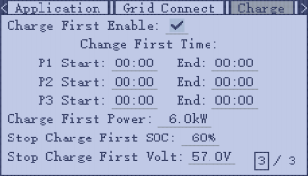

uu POWERTEK User Manual
4.1.2 Charge First Mode
The priority order of solar power usage will be Battery > Load > Grid. During Charge Priority time period, load is first supplied with grid power. If there is excess solar power after battery charging, the excess
solar power will take load together with grid power.
> Application Scenarios
When users want to use solar power to charge battery, grid power to supply load.
> Related Settings
> Example
 |  |  |  |  | PV 1 PV 2 | 22 W 278.7 V 700 W 452.8 V
103 W Charge Power |  |  | V V |  | Solar power |  |  |  | 0 W
201% | 2
 |  |  |  |  |  |  |  |  | 3
 |  |  |  |  |  |  | 1
 |  |  |  |  |  |  |  |  | 249.2Vac 49.94Hz
Battery Level(SOC)
57Vdc |  |  |  | Standby Backup Power(Load) |  |  |  | 567 W Consumption Power
● Normal
LU PO Nornal Fault Return UP Down Enter
R
Solar power will used to charge battery first, if there is extra power, it will be used to take load.
32

Slide 37
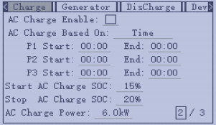
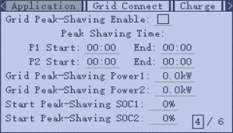
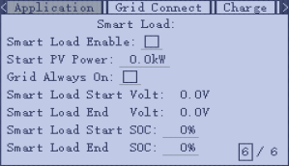
uu POWERTEK User Manual
4.1.3 AC Charge Mode
Users can charge batteries with grid power when electricity prices are cheap, and discharge battery power to supply load or export to the grid when electricity prices are high.
> Application Scenarios
When users have a Time of Use(TOU) rate plan.
4.1.4 Grid peak-shaving Function
Grid peak-shaving & Grid peak-shaving
power(kW):
Is used to set the maximum power that the
inverter will draw from its grid power. And the
Peak-shaving power needs to be set to more than 0.2(KW).
4.1.5 Smart Load Function
Smart Load: This function is to make the Gen input
connection point as an load connection point, if you enable it,inverter will supply power to this
load when the battery SOC and PV power is above a user setup value.e.g. Smart load start SOC=90%, Smart load end SOC=85%,Start PV power=300W, it means: When the PV power exceeds 300w, and the battery system SOC gets to 90%,the Smart
Load Port will switch on automatically to supply the load which is connected on this side. When
the battery reaches SOC<85% or PV power<300w, the Smart Load Port switch off automatically.
> Related Settings
Note:
If you enable the Smart load function, it’s forbidden to connect the generator at the same time, otherwise the device will be
damaged!
33

Slide 38
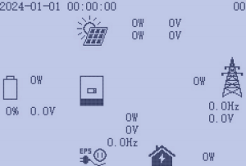
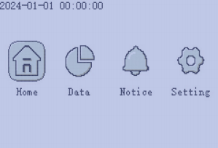
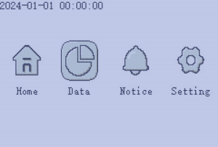
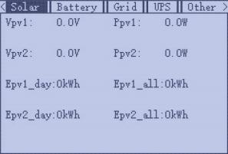
uu POWERTEK User Manual
4.2 LCD Display
Users can view inverter running status, realtime power, daily and accumulated energy information conveniently on inverter LCD. In addition to the above information, users can also check alarm and fault record on the display for
troubleshooting.
4.2.1 Viewing information and alarm/fault record
Home Page
Users will see a system overview diagram and real-time information for each component, such as battery SOC, battery charging/discharging
power, grid input/output power, load power, PV voltage, and power.
Content
Press the Enter key to enter the directory page.
Detailed System Information
Select the Data function in the directory, and you'll be able to view detailed real-time solar information, battery information, grid information, and Load output information.
34

Slide 39












uu POWERTEK User Manual
Fault/Alarm Information
Select the Notice function in the menu, and you'll see all the current and historical fault and warning information on this page.
35

Slide 40




uu POWERTEK User Manual
4.2.2 Setting Parameters
Select the Setting function in the menu, and you'll get into the parameter setting page of the inverter.
a). Common settings
Normal/Standby: Is for users to set the inverter to normal status or to standby status. In standby
status,the inverter will stop any charging or
discharging operations, as well as solar-feed-in.
Restart Inverter: Restart the system, please note
the power maybe interrupted when restarted. you'll get into the parameter setting page of the inverter. Battery Type: No battery, lead-acid or lithium-ion. If lead-acid battery is selected, please input correct battery capacity. If lithium-ion battery is selected, please choose the batterybrand in the lithium brand drop down list.
Measurement: CT or Meter, default CT.
CT Sample Ratio: The supported CT ratio is 1000:1, 2000:1, 3000:1. Default CT ratio is 1000:1. If 3rd
party CT is to be used, please ensure its CT ratio is one of them, and set it accordingly.
CT direction reversed: If the CT are in a wrong
direction which will cause the display to show
incorrect information and features of the inverter
will not function correctly, the installer can modify it by selecting it (only for direction not CT placement), there is no need to reconnect the CT and no need to go change it physically, in the order of loads-grid export--battery charging.
Lead Acid: When using Lead-acid battery, you need to set parameters in these programs, Follow the
battery manufacturer's recommendation
36

Slide 41




uu POWERTEK User Manual
b). AppIication setting
Power Backup: It is for users to set if the inve比er
provides backup power or not when the grid is Iost. If users want the Ioad to be seamIessIy transferred to the inve比er backup power, "SeamIess EPS switching" must beenabIed. If customers don't have a battey instaIIed yet, but stiII wish to have inve比er backup power with onIy soIar paneIs connected, “PV Grid Off”
can beenabIed to use soIar power to suppIy Ioad when the grid faiIs or Ioad-shedding happens.
Micro-Grid: onIy needs to be set when the generator is connected to the inve比er's grid po比. With this option enabIed, the inve比er wiII use AC power to charge the battey and won't expo比 any power through the grid po比 if AC power is present at the inve比er's grid po比.
Grid Sell Back: Is for users to set a zero expo比 function. If expo比ing soIar power is not aIIowed, users need to
disabIe the “Grid SeII Back” option. If users' utiIity meter is tripped with even a IittIe soIar expo比,”Zero
expo比”can beenabIed Thus the expo比 detection and adjustment wiII take pIace evey 20mS,which wiII
effectiveIy avoid any soIar power being expo比ed. If
expo比 is aIIowed, users can enabIe “Grid SeII Back” and set a maximum aIIowabIe expo比 Iimit in “Grid SeII Back Power”.
Set Composed Phase: This is the phase code setting of the Load output. The system wiII automaticaIIy detect the phase sequence of the inve比er (consistent with the phase sequence of the connected Grid mains) and
dispIay on the inve比er after it is connected to the grid.
Set System Type: The RoIesetting of the paraIIeI
system. It is set to 1 phase primay by defauIt. In a
paraIIeI system, onIy one inve比er is aIIowed to be set as Primay, and the others are aII Subordinate.
Share Battery: When the inve比er is connected as a paraIIeI system, aII inve比ers need to share the battey, and set the “Share Battey” to “EnabIe” at the same time.
c). Grid Connect Setting
Connect Time: Set the countdown timer for on-grid.
37

Slide 42



uu POWERTEK User Manual
d). Charge Setting
Bat Charge Control: Users can decide to use SOC or BatV to control charge and discharge logic
depending on battery type. Charge Current Limit: Users can set the maximumcharge current (machine supports a maximum of 125A).
Charge last: When users want to use solar power in the order of loads - grid export - battery charging.
AC Charge: Utility charge configuration If users want to usegrid power to charge their battery, then they can enable “AC Charge”, set time periods when AC
charging can happen, AC Charge power (KW) to limit utility charging power, and “Stop AC Charge SOC(%)” as the target SOC for utilitycharging. “Stop AC
Volt(V)” as the target battery voltage for utility charging.
Bat charge current limit(A): Set the Max. battery
charge current from the Generator. The Generator will start charging according to the charge start Volt/SOC, and stop charging when the battery voltage or SOC reaches the Charge end Volt/SOC value.
o Gen rated power: Inverter has the peak-shaving
function,when you need you can enable it and setup the Gen peakshaving power(W).
e). Generator Setting
38

Slide 43




uu POWERTEK User Manual
f). Discharge Setting
Bat Discharge Control: You can choose “SOC”or “Volt” to control the battery discharge state.
Start Discharge P_import: When the inverter detects the import power is higher than this value, battery start discharging, otherwise
battery will keep standby.
o On-grid Cut-off(%) and Off-grid
Cut-off(%)/On-grid Cut-off(V) and Off-grid Cut-off(V):
End of discharge SOC/Cut off voltage in on-grid and off grid condition respectively.
Forced discharge: Settings for battery forced
discharge within certain time period. In the preset time period, the inverter will discharge battery at the power set by “discharge power”,until battery SOC or voltage reaches “Stop discharge” value.
Device information will display the serial number, firmware version, and current model information.
g). Device info
39

Slide 44


uu POWERTEK User Manual
4.3 LCD Screen Settings
4.3.1 Button Operation
Button | Function
ESC | Exit
ENTER | Confirm, Enter menu
UP | Previous level, Increase
DOWN | Next level, Decrease
Note: Long-pressing the UP and DOWN keys will continuously input the corresponding key signals.
4.3.2 General Operations
Through button control, press ENTER on the home screen to access the menu options.
Enter →
Using the UP and DOWN buttons, select the desired function, then press ENTER to enter. Press ESC to return to the previous level. The options include Home for the main page, Data for operational data,
Notice for fault and warning information, and Setting for configuration settings.
40

Slide 45










uu POWERTEK User Manual
4.3.3 Setting Operation
Once in the settings interface, you can use the buttons to navigate through various configuration options.
Exit to the previous level | Previous option | Next option | Set the selected option
Esc
Up
Down
Enter
In the settings menu, press Enter to select the setting item. The selected setting will be highlighted. Use the UP and DOWN buttons to navigate and select the desired content. Press Enter again to
confirm the setting (an "OK" animation will be displayed)
Exit to the previous level | Previous option | Next option | Confirm the setting and play the animation
Esc
Up
Down
Enter
41

Slide 46







uu POWERTEK User Manual
4.3.4 Faults & Warnings Function
Under the Faults & Warnings Function, in the Fault Status menu, you can view real-time fault information. When fault information is refreshed, the page will update accordingly.
The warning information works similarly. In the Record page, you can view historical fault and warning information.
4.3.5 Subpage Selection
For menus with subpages, indicated by a display in the bottom right corner, you can use the Enter button to navigate to the menu's subpages.
 |  |  | None
Exit to the previous level | Previous Subpage | Next Subpage | No subpage
Esc
Up
Down
Enter
42

Slide 47







uu POWERTEK User Manual
4.3.6 Special Operation
For certain special settings, such as configuring the battery, you need to press Enter on "SET" to confirm the
settings.
Keypad Operation
In certain settings, a keypad will pop up for input, as shown below.
Now, you can use the buttons to navigate the numeric keypad:
Go back to the previous level | Scroll to the previous value on the keypad | Scroll to the next value on the keypad | Confirm. In this case, the keypad shows "+50". Pressing confirm will increase the charge current limit by 50A.
Esc
Up
Down
Enter
43

Slide 48





uu POWERTEK User Manual
When you select the "Enter" key on the keypad, press "Enter" again to confirm the setting.
 |  | Enter
Long Press Operation: The UP and DOWN keys support long-press functionality. After holding down for a certain period, the key will continue to execute (i.e., repeatedly pressing the key).
5. Troubleshooting & Maintenance
5.1 Regular Maintenance Inverter Maintenance
a. Check the inverter every 6 months or 1 year to verify if there are damages on cables, accessories, terminals and the inverter itself.
b. Check the inverter every 6 months to verify if the operating parameter is normal and there is no abnormal heating or noise from the inverter.
c. Check the inverter every 6 months to confirm there is nothing that covers the inverter heat sink, if there is, shut-down the inverter and clear the heat sink.
Battery Maintenance
Follow the manufacturer's requirements on maintenance. When you carry out these works on batteries, please make sure to fully shut-down the inverter for safety consideration.
5.2 LED Displays
LED | Display | Description | Suggestion
Green LED | Solid light | Working normally
 | Flashing - - | Firmware upgrading | Wait till upgrading complete
Red LED | Solid light | Fault, inverter stop work | Need troubleshooting
5.3 Troubleshooting Based on LCD Displays
1. Fault on the LCD
Once there is any warning or fault occurring, users can troubleshoot according to the LED status and the warning/fault information on the LCD.
44

Slide 49
uu POWERTEK User Manual
Fault Code | Fault | Meaning | Troubleshooting
E00 | M3 Rx failure | M3 microprocessor fails to receive data from DSP | Restart inverter, if the error still exists, contact your supplier.
E01 | Model fault | Incorrect model value
E12 | EPS short circuit | Inverter detected short-circuit on Load output terminals | 1. Check if the L and N wires are connected correctly at inverter Load output port; 2. Disconnect the Load breaker to see if fault remains. If fault persists, contact your supplier.
E08 | Para Comm error | Parallel communication abnormal | 1. Please check whether the connection of the parallel cable is loose, please connect the parallel cable correctly 2. Please check and make sure the PIN status of CAN communication cable from the first to the end inverter rightly.
E09 | Para primary loss | No primary in the Parallel system | 1. If a primary has been configured in the system, the fault will be automatically removed after the primary works. If so, you can ignore it. 2. If a primary has not been configured in the system, and there are only subordinate in the system, please set the primary first. Note: For single unit running system, the role of the inverter should be set as “1 phase primary”
E10 | Para rating Diff | Rated power of parallel inverters are inconsistent | Please confirm that the rated power of all inverters are the same, or you can contact Luxpower service to confirm
E11 | Para Spec Diff | Inconsistent safety standards in parallel connection | The safety settings of each unit should be the same
E13 | EPS power reversed | Inverter detected power flowing into Load terminal | Restart inverter, if the error still exists, contact your supplier
E14 | Bus short circuit | DC Bus is short circuited
E15 | Para Phase Error | Incorrect setting of phase in parallel | Please confirm that the wiring of the parallel system is correct first. In this case, then connect each inverter to the grid, the system will automatically detect the phase sequence, and the fault will be automatically resolved after the phase sequence is detected.
E16 | Relay fault | Relay abnormal | Restart inverter, if the error still exists, contact your supplier
E17 | M8 Tx failure | DSP fails to receivedata from M8 microprocessor
E18 | M3 Tx failure | DSP fails to receivedata from M3 microprocessor
E19 | Vbus over range | DC Bus voltage too high | Please check if the PV string voltage is within the inverter specification. If string voltage is within range, and this fault still appears, contact your supplier.
45

Slide 50
uu POWERTEK User Manual
E20 | EPS connect fault | Load port and grid port are connected mixed up | Check if the wires on Load terminal and grid terminal are connected correctly. If the error exists, contact your supplier.
E21 | PV volt high | PV voltage is too high | Please check if the PV string voltage is within the inverter specification. If string voltage is within range, and this fault still appears, contact your supplier
E22 | Hard over curr | Hardware level over current protection triggered | Restart inverter, if the error still exists, contact your supplier
E23 | Neutral fault | Voltage between N and PE is greater than 30V | Check if the neutral wire is connected correctly
E24 | PV short circuit | Short circuit detected on PV input | Disconnect all PV strings from the inverter. If the error persists, contact your supplier.
E25 | Tempr Over Range | Heat sink temperature too high | Install the inverter in a place with good ventilation and having no direct sunlight. If the installation site is okay, please check if the NTC connector inside the inverter is loose.
E26 | Bus sample fault | Inverter detected DC bus voltage lower than PV input voltage | Restart inverter, if the error still exists, contact your supplier.
E27 | Inconsistant | Sampled grid voltage values of DSP and M8 microprocessor are inconsistent
E28 | Para Gen un Accord | Inconsistent generator connect in paralle | Some inverters are connected to generators, some are not. please confirm that all inverters in parallel are connected to generators together or none of them are connected to generators
E29 | Para sync loss | Parallel inverter fault | Restart inverters, if the error still exists, contact Luxpower service or your inverter supplier
E31 | M8 Rx fault | M8 microprocessor fails to receivedata from DSP | Please confirm that the rated power of all inverters are the same, or you can contact Luxpower service to confirm
46

Slide 51



uu POWERTEK User Manual
2. Alarm on the LCD
When there are errors, they will be displayed in real-time on the "Notice -> Alarm Status" page.
Warning Code | Alarm | Meaning | Troubleshooting
W00 | Bat com failure | Inverter fails to communicate with battery | Check if communication cable is correct, and if you have chosen the correct battery brand on inverter LCD. If all is correct but this error persists, please contact your supplier.
W03 | Meter Com Fail/CT Disconnected | Inverter fails to communicate with the meter | 1. Check if the L and N wires are connected correctly at inverter Load output terminal; 2. Disconnect the Load breaker to see if fault remains. If fault persists, contact your supplier.
W04 | Battery Failure | Battery cannot charge or discharge | 1. Check the battery communication cable for correct pinout on both inverter and battery end; 2. Check if you have chosen an incorrect battery brand; 3. Check if there is fault on battery's indicator. If there is fault, please contact your battery supplier.
W05 | Auto test failure | Auto test failed | Only applied to Italy model
W07 | Lcd com failure | LCD fails to communicate with M3 microprocessor | Restart inverter. If fault still exists, contact your supplier.
W08 | Fw mismatch | Firmware version mismatch between the microprocessors
W09 | Fan stuck | Cooling fans are stuck
W10 | AC Input Over Load | AC Input Overload/ GEN Input Overload | Input power must not exceed the set maximum for AC input or generator input.
W12 | Para phase loss | Phase losing in parallel system | Please confirm that the wiring of the inverter is correct. If the primary is set to 3 Phase primary, contact your supplier. the number of parallel inverters needs to be ≥3. (And the grid input of each inverter should be connect with Grid L rightly).
W13 | Para no BM set | Primary isn’t set in the parallel system | Please set one of the inverters in the parallel system as the primary
47

Slide 52

User Manual
W14 | Para multi BM set | Multiple Primary have been set in the parallel system | There are at least two inverters set as Primary in the parallel system, please keep one Primary and the other set as Sunordinate
W21 | Trip by gfci high | Inverter detected leakage current on AC side | 1. Check if there is ground fault on grid and load side; 2. Restart inverter. If the fault remains, contact your supplier
W22 | Trip by dci high | Inverter detected high DC injection current on grid port | Restart inverter. If the fault remains, contact your supplier.
W23 | PV short circuit | Inverter detected short circuit PV input | 1. Check if each PV string is connected correctly; 2. Restart inverter. If the fault remains, contact your supplier.
W24 | GFCI module fault | GFCI module is abnormal | Restart inverter. If fault still exists, contact your supplier
W25 | Bat volt high | Battery voltage too high | Check if battery voltage exceeds 59.9V, battery voltage should be within inverter specification.
W26 | Bat volt low | Battery voltage too low | Check if battery voltage is under 40V, battery voltage should be within inverter specification.
W27 | Bat open | Battery is disconnected from inverter | Check battery breaker or battery fuse
W28 | Offgrid overload | Overload on Load port | Check if load power on inverter Load port is within inverter specification.
W29 | OffGrid OverVolt | EPS Voltage is too high | Restart inverter. If fault still exists, contact your supplier.
5.4 Fan replacement
Please check and clean the fans regularly. The recommended period is 6 months. Please replace the fan following up the below diagram if there is problem with the fans. Turn off the system and wait for more than 5 minutes before disassembling the machine.
Use a screwdriver to remove the nut here.
Do not disconnect
DEVALAN
DEVALAN
EVALAN
DEVALAN
under load
DEVALAN
DEVALAN
Do not disconnect
under load
Do not disconnect
under load
PV1-
PV2+
PV2-
PV1+
48

Slide 53
uu POWERTEK User Manual
PV Input data |  | 3K | 3.6K
Max . usable input current(A) |  | 18/18 | 18/18
Max . short circuit input current(A) |  | 32/32 | 32/32
Start input voltage(V) |  | 100 | 100
Startup voltage(V) |  | 140 | 140
Power MPPT voltage range(V) |  | 150-425 | 150-425
DC nominal voltage(V) MPPT tracker |  | 360 | 360
DC voltage range(V) |  | 100-530 | 100-530
Max . power(W) |  | 6600 | 6600
Number of MPPT |  | 2 | 2
AC output data(On-Grid)
Nominal Output Current(A) | 13 |  | 15.7
Rated voltage(V) | 230 |  | 230
Operating voltage range(V) | 180-270 |  | 180-270
Nominal power output(W) | 3000 |  | 3600
Operating frequency( Hz) | 50/60 |  | 50/60
Operating frequency range( Hz) | 45-55/55-65 |  | 45-55/55-65
Phase shift | 0.99@full load |  | 0.99@full load
Reactive power adjust range | -0.8~+0.8 leading Adjustable |  | -0.8~+0.8 leading Adjustable
THDI | <3% |  | <3%
Sync in rush cure nt(A) | 35 |  | 35
AC output data(Backup)
Nominal output current(A) | 13 |  | 15.7
Nominal output voltage(V) | 230 |  | 230
Rated output power(VA) | 3000 |  | 3600
Operating frequency( Hz) | 50 |  | 50
Peak power(VA) | 2xPn , 0. 5s |  | 2xPn , 0. 5s
THDV | <3% |  | <3%
Switching Time | <20 |  | <20
Efficiency
Europe Efficiency | 96% |  | 96%
Max . Efficiency @ PV to grid | 97.5% |  | 97.5%
Max.Efficiency @ battery to grid | 94% |  | 94%
MPPT Efficiency | 99.9% |  | 99.9%
Battery data
Type | Lead-acid battery/Lithium battery
Max . charge current(A) | 80 |  | 80
Max . discharge current(A) | 80 |  | 80
Nominal voltage(V) | 48 |  | 48
Voltage range(V) | 40-60 |  | 40-60
Max . voltage(V) | 60 |  | 60
General Data
Integrated disconnect DC switch |  |  | DC switch
Reverse polarity protection Yes |  |  | Yes
DC switch rating for each MPPT ^{Yes} |  |  | Yes
Output over-voltage protection varistor Yes |  |  | Yes
Output over current protection Yes |  |  | Yes
Ground fault monitoring Yes |  |  | Yes
Grid monitoring Yes |  |  | Yes
Pole sensitive leakage current Yes |  |  | Yes
Dimensions( mm) 487*455*211 .7mm( 19.2*17 .9*8 .3inch) |  |  | 487*455*211 .7mm( 19.2*17 .9*8 .3inch)
Weight (kg) 29kg (63.9 Ib s) |  |  | 29kg (63.9 Ib s)
Degree of protection NEMA4X / IP 65 |  |  | NEMA4X / IP 65
Cooling concept FAN |  |  | FAN
Topology Transformer-less |  |  | Transformer-less
Relative humidity 0-100% |  |  | 0-100%
Altitude ( m) <2000m |  |  | <2000m
Noise emission(dB) Internal consumption(W) | 50dB <15W |  | 50dB <15W
Display LCD |  |  | LCD
Communication interface RS485/ Wi-Fi/ CAN |  |  | RS485/ Wi-Fi/ CAN
^{Standard} ^{warranty} 5years |  |  | 5years
49

Slide 54
uu POWERTEK User Manual
PV Input data |  | 4K | 4.6K
Max . usable input current(A) |  | 18/18 | 18/18
Max . short circuit input current(A) |  | 32/32 | 32/32
Start input voltage(V) |  | 100 | 100
Startup voltage(V) |  | 140 | 140
Power MPPT voltage range(V) |  | 150-425 | 150-425
DC nominal voltage(V) MPPT tracker |  | 360 | 360
DC voltage range(V) |  | 100-530 | 100-530
Max . power(W) |  | 7000 | 9000
Number of MPPT |  | 2 | 2
AC output data(On-Grid)
Nominal Output Current(A) | 17.4 |  | 20
Rated voltage(V) | 230 |  | 230
Operating voltage range(V) | 180-270 |  | 180-270
Nominal power output(W) | 4000 |  | 4600
Operating frequency( Hz) | 50/60 |  | 50/60
Operating frequency range( Hz) | 45-55/55-65 |  | 45-55/55-65
Phase shift | 0.99@full load |  | 0.99@full load
Reactive power adjust range | -0.8~+0.8 leading Adjustable |  | -0.8~+0.8 leading Adjustab e
THDI | <3% |  | <3%
Sync in rush cure nt(A) | 35 |  | 35
AC output data(Backup)
Nominal output current(A) | 17.4 |  | 20
Nominal output voltage(V) | 230 |  | 230
Rated output power(VA) | 4000 |  | 4600
Operating frequency( Hz) | 50 |  | 50
Peak power(VA) | 2xPn , 0. 5s |  | 2xPn , 0. 5s
THDV | <3% |  | <3%
Switching Time | <20 |  | <20
Efficiency
Europe Efficiency | 96% |  | 96%
Max . Efficiency @ PV to grid | 97.5% |  | 97.5%
Max.Efficiency @ battery to grid | 94% |  | 94%
MPPT Efficiency | 99.9% |  | 99.9%
Battery data
Type | Lead-acid battery/Lithium battery
Max . charge current(A) | 80 |  | 96
Max . discharge current(A) | 80 |  | 96
Nominal voltage(V) | 48 |  | 48
Vo tage range(V) | 40-60 |  | 40-60
Max . voltage(V) | 60 |  | 60
General Data
Integrated disconnect DC switch |  |  | DC switch
Reverse polarity protection Yes |  |  | Yes
DC switch rating for each MPPT ^{Yes} |  |  | Yes
Output over-voltage protection varistor Yes |  |  | Yes
Output over current protection Yes |  |  | Yes
Ground fault monitoring Yes |  |  | Yes
Grid monitoring Yes |  |  | Yes
Pole sensitive leakage current Yes |  |  | Yes
Dimensions( mm) 487*455*211 .7mm( 19.2*17 .9*8 .3inch) |  |  | 487*455*211 .7mm( 19.2*17 .9*8 .3inch)
Weight (kg) 29kg (63.9 Ib s) |  |  | 29kg (63.9 Ib s)
Degree of protection NEMA4X / IP 65 |  |  | NEMA4X / IP 65
Cooling concept FAN |  |  | FAN
Topology Transformer-less |  |  | Transformer-less
Relative humidity 0-100% |  |  | 0-100%
Altitude ( m) <2000m |  |  | <2000m
Noise emission(dB) Internal consumption(W) | 50dB <15W |  | 50dB <15W
Display LCD |  |  | LCD
Communication interface RS485/ Wi-Fi/ CAN |  |  | RS485/ Wi-Fi/ CAN
^{Standard} ^{warranty} 5years |  |  | 5years
50

Slide 55
uu POWERTEK User Manual
PV Input data |  | 5K | 6K
Max . usable input current(A) |  | 18/18 | 18/18
Max . short circuit input current(A) |  | 32/32 | 32/32
Start input voltage(V) |  | 100 | 100
Startup voltage(V) |  | 140 | 140
Power MPPT voltage range(V) |  | 150-425 | 150-425
DC nominal voltage(V) MPPT tracker |  | 360 | 360
DC voltage range(V) |  | 100-530 | 100-530
Max . power(W) |  | 9000 | 9000
Number of MPPT |  | 2 | 2
AC output data(On-Grid)
Nominal Output Current(A) | 21.7 |  | 26
Rated voltage(V) | 230 |  | 230
Operating voltage range(V) | 180-270 |  | 180-270
Nominal power output(W) | 5000 |  | 6000
Operating frequency( Hz) | 50/60 |  | 50/60
Operating frequency range( Hz) | 45-55/55-65 |  | 45-55/55-65
Phase shift | 0.99@full load |  | 0.99@full load
Reactive power adjust range | -0.8~+0.8 leading Adjustable |  | -0.8~+0.8 leading Adjustable
THDI | <3% |  | <3%
Sync in rush cure nt(A) | 35 |  | 35
AC output data(Backup)
Nominal output current(A) | 21.7 |  | 26
Nominal output voltage(V) | 230 |  | 230
Rated output power(VA) | 5000 |  | 6000
Operating frequency( Hz) | 50 |  | 50
Peak power(VA) | 2xPn , 0. 5s |  | 2xPn , 0. 5s
THDV | <3% |  | <3%
Switching Time | <20 |  | <20
Efficiency
Europe Efficiency | 96% |  | 96%
Max . Efficiency @ PV to grid | 97.5% |  | 97.5%
Max.Efficiency @ battery to grid | 94% |  | 94%
MPPT Efficiency | 99.9% |  | 99.9%
Battery data
Type | Lead-acid battery/Lithium battery
Max . charge current(A) | 105 |  | 125
Max . discharge current(A) | 120 |  | 140
Nominal voltage(V) | 48 |  | 48
Voltage range(V) | 40-60 |  | 40-60
Max . voltage(V) | 60 |  | 60
General Data
Integrated disconnect DC switch |  |  | DC switch
Reverse polarity protection Yes |  |  | Yes
DC switch rating for each MPPT ^{Yes} |  |  | Yes
Output over-voltage protection varistor Yes |  |  | Yes
Output over current protection Yes |  |  | Yes
Ground fault monitoring Yes |  |  | Yes
Grid monitoring Yes |  |  | Yes
Po e sensitive eak age current Yes |  |  | Yes
Dimensions( mm) 487*455*211 .7mm( 19.2*17 .9*8 .3inch) |  |  | 487*455*211 .7mm( 19.2*17 .9*8 .3inch)
Weight (kg) 29kg (63.9 Ib s) |  |  | 29kg (63.9 Ib s)
Degree of protection NEMA4X / IP 65 |  |  | NEMA4X / IP 65
Cooling concept FAN |  |  | FAN
Topology Transformer-less |  |  | Transformer-less
Relative humidity 0-100% |  |  | 0-100%
Altitude ( m) <2000m |  |  | <2000m
Noise emission(dB) Internal consumption(W) | 50dB <15W |  | 50dB <15W
Display LCD |  |  | LCD
Communication interface RS485/ Wi-Fi/ CAN |  |  | RS485/ Wi-Fi/ CAN
^{Standard} ^{warranty} 5years |  |  | 5years
51

Slide 56

YOUR RELIABLE ENERGY SOLUTIONS PARTNER
luxpowertek
Lux Power Technology Co., Ltd
Headquarter: +86 755 8520 9056 www.luxpowertek.com
Contact us: info@luxpowertek.com
092.20043AC

